Slide 1
Magnetic Loop Antennas for RDF, Receiving, Transmitting Friday February 2nd 2018
Hamfesters Radio Club
By Gregory D. Rosenberg (AB9MZ).

Slide 2
Why Should You Care
Because we love to build things
Because learning something new will stave off dimension
Because it is fun
Do we really need a reason

Slide 3
Introduction
A loop antenna is a radio antenna consisting of a loop or coil of wire, tubing, or other electrical conductor usually fed by a balanced source or feeding a balanced load.
Within this physical description there are two distinct antenna types. The large self-resonant loop antenna has a circumference close to one wavelength of the operating frequency and so is resonant at that frequency.
This category also includes smaller loops 5% to 30% of a wavelength in circumference, which use a capacitor to make them resonant. These antennas are used for both transmission and reception.
In contrast, small loop antennas less than 1% of a wavelength in size are very inefficient radiators, and so are only used for reception.
An example is the ferrite (loopstick) antenna used in most AM broadcast radios.
Loop antennas have a dipole radiation pattern; they are most sensitive to radio waves in two broad lobes in opposite directions, 180° apart. Due to this directional pattern they are used for radio direction finding (RDF), to locate the position of a transmitter.

Slide 4
What Can I Do With Loop Antennas
They were used substantially for Parks on the Air in 2017.
They are often used for Summits on the Air (SOA).
They can be used for winter or summer field day.
If your transceiver has a receive input they can be used as receive antennas.
If you have antenna restrictions they can easily be put up in an attack space.
Loop antennas are fairly portable & can be used for ad-hoc operating.
They are great for Radio Direction Finding (RDF) (aka Fox hunting).

Slide 7
Loop Antennas for Radio Direction Finding (RDF)
What do you need for RDF?
You need a very directional antenna.
A device for detecting the radio signal.
In amateur radio RDF applications the signal detector is usually a receiver.
It can also be a transceiver that you only use for receiving. Unmodified, commercially available portable or mobile receivers are generally quite satisfactory for signal detectors.
A signal strength meter can be used close in to indicate signal strength when you get close.
And at very close ranges a simple diode detector and dc micro-ammeter may suffice for the detector.

Slide 8
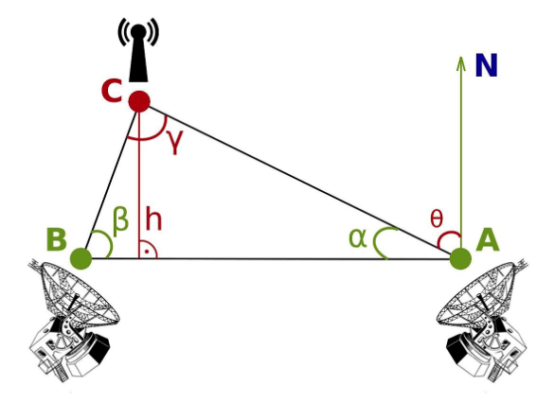
Triangulating with two RDF Antennas

Slide 9
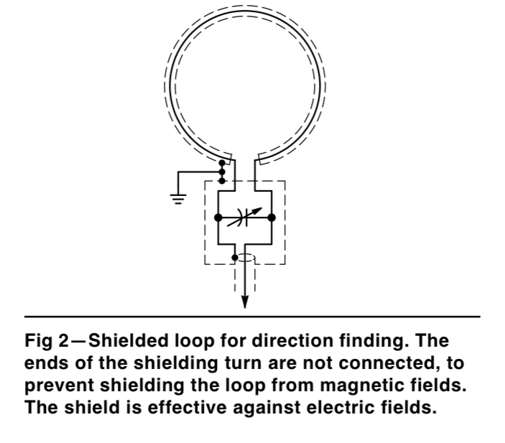
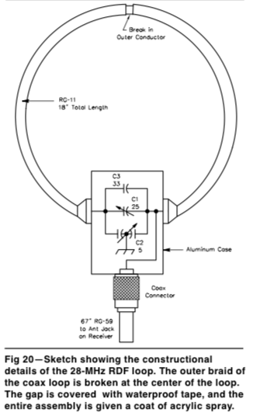
Shielded Loop antenna for RDF

Slide 10
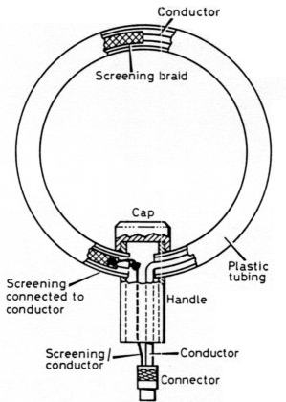
A Closer Look at a Loop Antenna for RDF

Slide 11
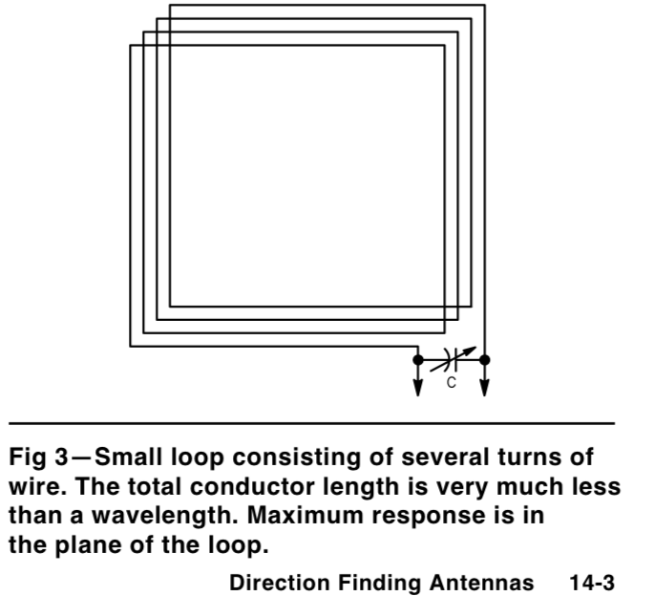
Multi-Turn Loop Antenna for RDF

Slide 12
Design Characteristics of a RDF Loop Antenna
It should be light weight.
It should be small enough to be portable.
It could be built as an octagon that uses couplings so it can be assembled in the field.
If you operate stationary you should include a ground rod and #8 or larger grounding cable in your kit.
If you operate mobile you need to consider how you will mount it on your vehicle.
A pickup truck with a tripod mounted on a sheet of plywood is an effective strategy.
A PVC pipe clamped between the underside of a car and its rough (protected by a blanket).
Back in 1964 Frank Spearman (From Frank’s TV on SW Highway) took his side mirror off and rigged the mirror control to rotate the RDF antenna.
I have seen folks using a motorized rear bumper mount controlled with a remote control in the car or a Raspberry PI or other micro-controller.

Slide 13
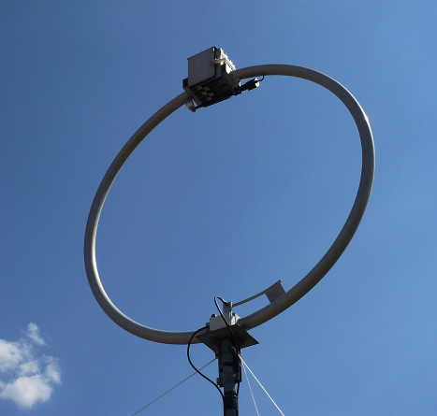
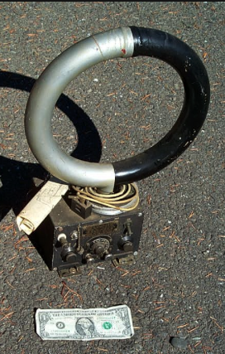
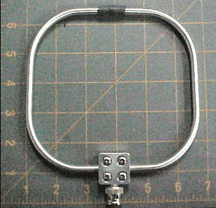
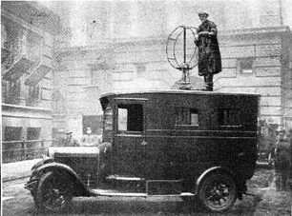
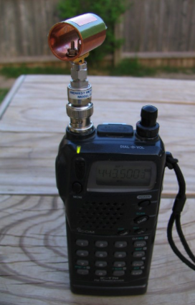
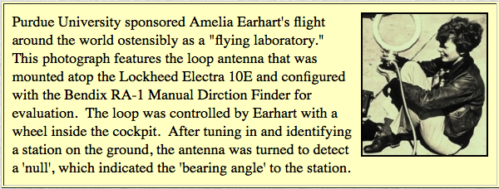
Examples of RDF Loop Antennas

Slide 15
Loop Antennas for Receiving

Slide 16
Design Characteristics of a Receiving Loop Antenna
Follow Antenna best practices when planning your location
They can be as small as an AM Antenna. 1% of the wavelength you wish to receive.
They can be medium to large in size & have multiple loops to cover many different frequency ranges.
Since you are not transmitting with them you don’t need expensive air variable capacitors.
They should be mounted on a non-metallic pole. Schedule 80 PVC works well for small to medium size loop antennas used for receiving.
You can control them with a motor and some type of remote control. The motor shaft needs to be insulated (isolated) from the loop antenna by 18. to 24”.

Slide 19
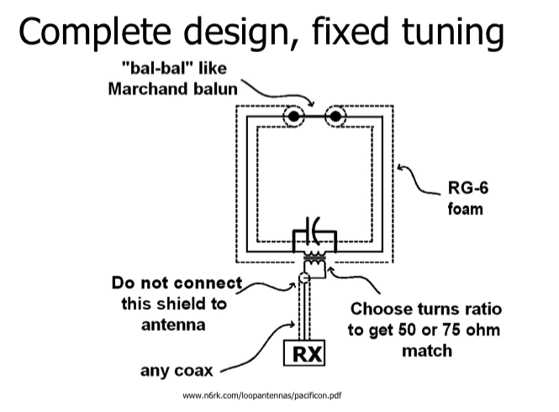

Slide 20
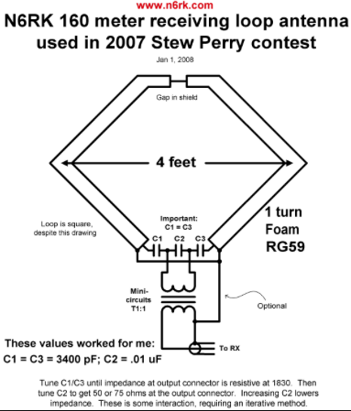
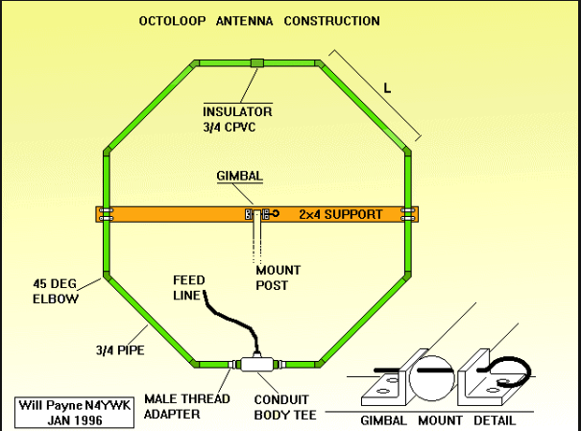
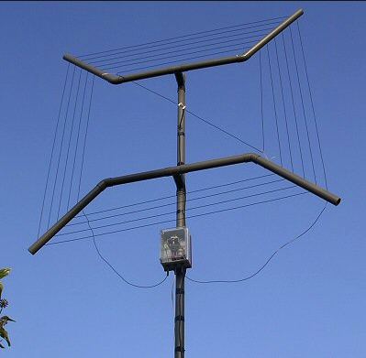
Examples of a Receiving Loop Antenna

Slide 21
Loop Antennas for Transmitting (1 of 5)
Small Transmitting Loop Antenna Calculator
Small transmitting loop antennas, commonly called "magnetic loops" or "mag loops," can give surprisingly good performance when they are carefully designed and constructed. Although this online calculator is intended to assist with designing and building homemade, ham radio loop antennas for use in the HF bands, magnetic antennas have been constructed that function in the VHF or even the UHF frequencies.
The most common material for home building small ham radio loop antennas is common copper plumbing pipe.
This calculator enables you to test the design of an octagonal loop antenna and to answer "what if" questions until you arrive at a design that meets your needs without a lot of experience in electronics.
You can find the calculator at the following link: http://www.66pacific.com/calculators/small-transmitting-loop-antenna-calculator.aspx

Slide 22
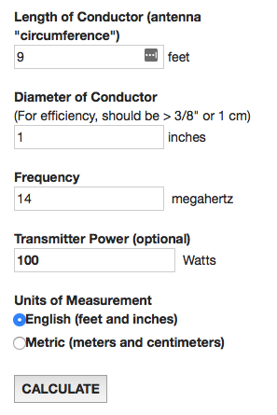
Loop Antennas for Transmitting (2 of 5)
Lets try the calculator
To use the calculator: 1. Choose the units of measurement. 2. Enter the length of the antenna conductor, which is the distance around the loop. The length should be between 0.1 and 0.25 wavelength at the desired operating frequency. 3. Enter the diameter of the conductor. Note: Small transmitting loops have very low radiation resistance and very high circulating current, so the diameter of the conductor must be large to assure reasonable efficiency around 1" for the HF bands. 4. Enter the frequency of operation. 5. Enter the transmitter power. This is optional, but it must be entered if you want to calculate the voltage at the capacitor and the circulating current. 6. Press Calculate.

Slide 23
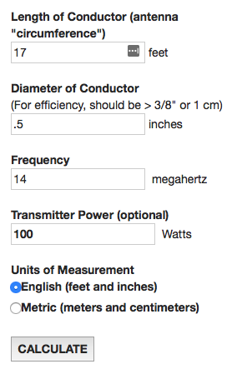
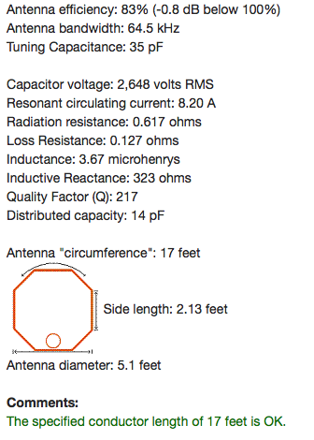
…Another Xmit Example
For highest efficiency, the conductor length for a small transmitting loop antenna should be greater than 1/8 wavelength (greater than about 8.52 feet at the specified frequency of 14 MHz). To avoid self-resonance, the conductor length for a small transmitting loop antenna should be less than 1/4 wavelength (less than about 17.0 feet at the specified frequency of 14 MHz).

Slide 24
Yet Another Xmit Loop Calculator
http://www.wb5cxc.com/smallloop1.html

Slide 25
Loop Antennas for Transmitting (3 of 5)
Antenna efficiency: 59% (-2.3 dB below 100%) Antenna bandwidth: 13.2 kHz Tuning Capacitance: 65 pF Capacitor voltage: 4,290 volts RMS Resonant circulating current: 24.7 A Radiation resistance: 0.048 ohms Loss Resistance: 0.034 ohms Inductance: 1.98 Mh Inductive Reactance: 174 ohms Quality Factor (Q): 1,059 Distributed capacity: 7 pF

Slide 26
Loop Antennas for Transmitting (4 of 5)
Conductor length should be between 8.52 and 17.0 feet at the specified frequency of 14 MHz. For highest efficiency, the conductor length for a small transmitting loop antenna should be greater than 1/8 wavelength (greater than about 8.52 feet at the specified frequency of 14 MHz). To avoid self-resonance, the conductor length for a small transmitting loop antenna should be less than 1/4 wavelength (less than about 17.0 feet at the specified frequency of 14 MHz). Input Values: Length of conductor: 9 feet Diameter of conductor: 1 inches Frequency: 14 MHz Transmitter power: 100 watts

Slide 27
Loop Antennas for Transmitting (5 of 5)
Source:
The ARRL Antenna Book: The Ultimate Reference for Amateur Radio Antennas, Transmission Lines And Propagation
References:
The ARRL Handbook for Radio Communications
Related Web Pages:
Design your own tuning capacitor for use with this antenna with the Capacitance Calculator (Capacitor Design)

Slide 28
Design Characteristics of a Transmit Loop Antenna
At higher transmit power levels you get very dangerous voltages and current in the loop.
You can overcome this by using lower power when operating.
A better approach is to use an Vacuum Air Variable Capacitor.
If you use a motor to turn the capacitor remotely it must be insulated (isolated) from the capacitor by at least 18” to 24” using PVC, a doll rod, or some type of hard plastic tube.

Slide 29
Special Considerations for a Xmit Loop Antenna
Most Xmit loops use a secondary coupling loop.
They will normally have an isolated motor driven capacitor.
You must insulate (isolate) the motor using a non-conductive rod or pipe. (PVC, dowel rod, …)
You don’t have to use a Vacuum Air Variable Capacitor as long as you operate a very low power 300mw to say 5W.

Slide 30
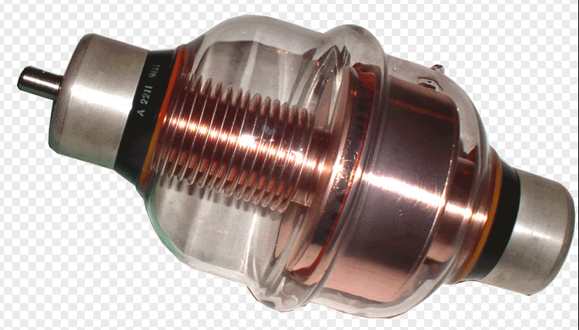
Vacuum Air Variable Capacitors
A Vacuum Air Variable Capacitor rated at 10K V and 0-500mF

Slide 31
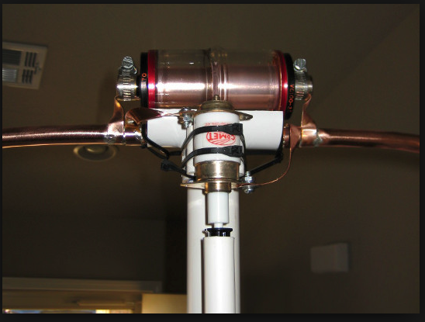
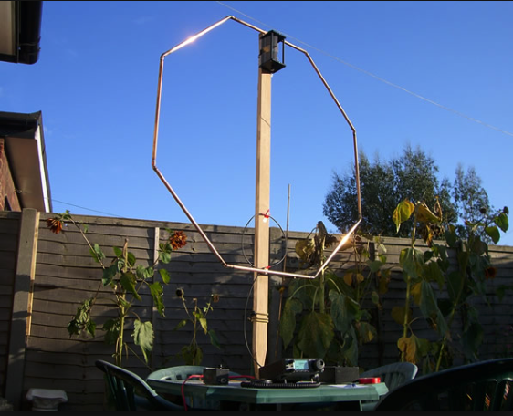
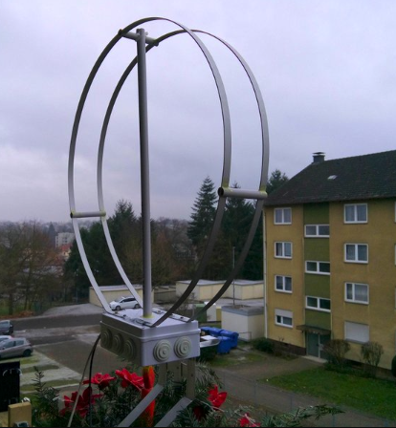
Examples of Xmit Loop Antennas
A close-up showing the mounted Vacuum Air Variable Capacitor and the PVC used to isolate the motor that tunes the capacitor.
A great garden decoration ☺

Slide 32
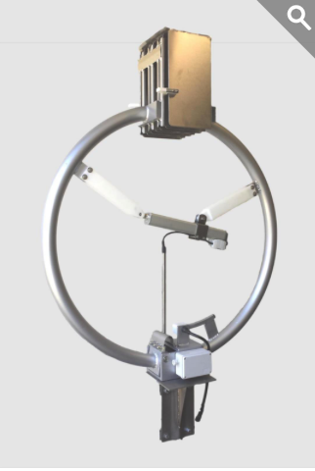
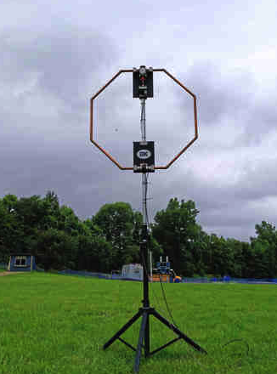
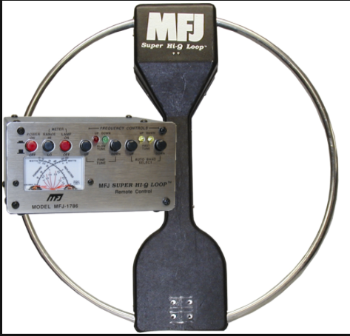
Examples of Commercial Xmit Loop Antennas

Slide 33
DIY Materials for Loop Antennas
Schedule 40 or 80 PVC, PVC couplers, PVC cement, sand paper.
3/8” or larger Copper pipe and fittings. The bigger the better. Copper fittings to create the desired shape if using copper pipe.
Coax cable. Again bigger is always better.
One or more fixed and variable tuning capacitors depending on your loop design.
An insulated support to mount your loop on (and potentially turn it). Wood, PVC, heavy plastic conduit.
SO-239 or N-Male depending on your design.
A plastic or metal box to mount your components in. Again depends on your design. Plastic is OK for RDF and RX loops, but metal is better for TX loops.
Misc. screws and other mounting hardware. Plastic zip ties,

Slide 34
Commercially Available Loop Antennas
From QRZ
MFJ has a line of small transmitting loop tuners. There is some technical information about RF exposure and loop sizes by frequency that I extracted from the MFJ manuals and posted in these articles for easy reference. http://frrl.wordpress.com/2009/03/21/limited-space-antennas-the-small-transmitting-loop-antenna/ http://frrl.wordpress.com/2009/06/07/small-transmitting-loop-tuners-from-mfj/
KE9ZM, Jun 14, 2009

Slide 35
References
Loop antenna – Wikipedia https://en.wikipedia.org/wiki/Loop_antenna
Small Transmitting Loop Antenna Calculator http://www.66pacific.com/calculators/small-transmitting-loop-antenna-calculator.aspx Portable Small Magnetic Loop for Transmitting https://www.nonstopsystems.com/radio/frank_radio_antenna_magloop-small.htm An excellent and very technical presentation on RX loops http://www.n6rk.com/loopantennas/pacificon.pdf
A nice paper on loop antennas and RDF. https://www.qrz.ru/schemes/contribute/arrl/chap14.pdf

Slide 36
??? Questions ???

